Slide 1
Al-based tool for preliminary diagnosis of Dermatological manifestations
CSE7101- Capstone Project
Review-2
Batch Number: CIT_23
Under the Supervision of,
Dr. Mohammad Buran Basha
Assistant Professor
Presidency School of Engineering, Department of Electronics and Communication Engineering
Roll Number | Student Name
20221CIT0085 | VINOD
20221CIT0077 | NALLIN KUMAR AB
20221CIT0068 | DEEKSHA D
Name of the Program: CIT-Computer Science & Engineering (Internet of Things)
Name of the HoD: Dr. Anandaraj S.P
Name of the Program Project Coordinator: Dr. Sharmasth Vali
Name of the School Project Coordinators: Dr. Sampath A K , Dr. Geetha Arjunan

Slide 2
Problem Statement Number:
Skin diseases are the 4th leading cause of nonfatal disease burden worldwide.
Many are linked to serious systemic illnesses such as HIV and neglected tropical diseases (NTDs).
These conditions affect mental health, daily functioning, and social participation of patients.
Access to dermatological care is limited in underserved and resource-poor regions.
Barriers include lack of efficient diagnostic tools, poor infrastructure, and scarcity of trained physicians.
Even preliminary screening of skin conditions is challenging without expert support.
An AI-based image processing tool can provide cost-effective and accessible preliminary diagnosis, improving healthcare delivery.

Slide 3
Content
Abstract
Literature Survey
Objectives
Proposed Method & Feasibility
Architecture Diagram
Modules
Software details
Results
Timeline of the project
References

Slide 4
Abstract
Skin diseases are among the top causes of nonfatal global health burden, yet there is a severe shortage of dermatologists in rural and resource-limited regions.
AI-based diagnostic systems using ResNet have demonstrated high accuracy, with reported performance ranging between 85–97% on curated datasets.
This project proposes the development of a lightweight tool that can provide preliminary diagnosis for common dermatological conditions.
The disease type will be detected and displayed to the user through a web or mobile interface.

Slide 5
Literature Survey
Title | Author | Model | Accuracy | Advantages | Drawbacks
Deep Learning-Based Dermatological Condition Detection: A Systematic Review (IEEE) | Multiple | ResNet50 | 70–98% across datasets (ISIC, HAM10000) | Widely tested, strong image features, transfer learning ready | Heavy, risk of overfitting, accuracy drops on external data
External Validation of AI Models for Skin Diseases: A Systematic Review (IEEE) | Multiple | ResNet50 | Internal: ~90%, External: 70–80% | Proves real-world gaps, shows need for diverse data | Very few external trials, bias toward light skin
Recent Advancements in Diagnosis of Skin Diseases Using ML/DL: A Review (MDPI, Diagnostics) | Multiple | EfficientNet | Up to 95% (ResNet50 on HAM10000) |  | Needs tuning, limited external validation
The Emerging Role of AI in Dermatology: A Systematic Review (MDPI, Dermato) | Multiple | ResNet | Varies | Clinical workflow focus, triage & telemedicine applications | Limited clinical evidence, early-stage adoption
The Use of AI for Skin Disease Diagnosis in Primary Care (MDPI, Healthcare) | Multiple | Inception-v3 | 70–90% | Helps General doctors with 1st checks, reduces unnecessary referrals | Few real-world trials, dataset bias risk
High accuracy with fewer parameters, scalable. Faster than ResNet

Slide 6
Literature Survey
Title | Author | Model | Accuracy | Advantages | Drawbacks
Recent Advances in Diagnosis of Skin Lesions Using Dermoscopy (IEEE) | Multiple |  | 80–95% | High dermoscopy accuracy, transfer learning effective | May fail on poor-quality or non-dermoscopy photos
High-Precision Skin Disease Diagnosis via DL on Dermoscopic Images (MDPI, Bioengineering) | Multiple | ResNet50 | ~95% | Very high accuracy in research datasets | Limited diversity, not tested in diverse populations
Interpretable AI for Enhanced Skin Lesion Classification (MDPI, Diagnostics) | Multiple | ResNet50 + Grad-CAM | 85–93% | Explainable predictions, increases doctor trust | Slightly less accurate, explanations ambiguous
AI for Skin Disease Diagnosis in Primary Care: A Systematic Review (MDPI, Applied Sciences) | Multiple | MobileNet | 70–90% | Lightweight, works on mobile/edge devices | Lower accuracy, weak on complex lesions
Multimodal Approach Using Telegram Chatbot (IEEE) | Multiple | ResNet (images) + NLP (text) | ~85% | Combines photos + symptoms, good for telemedicine | Prototype only, small dataset, no clinical validation
EfficientNet-B0

Slide 7
Objectives
To develop an AI-based tool for the preliminary diagnosis of skin diseases to help users identify conditions without immediate access to a dermatologist.
To build a CNN model that can classify skin diseases effectively.
To achieve a validation accuracy of at least 85% during model testing to ensure reliable predictions.
To ensure the model is lightweight so it can run smoothly on mobile devices and web platforms with limited resources.
To use a lightweight dataset such as DermNet that is easier to train while still covering a wide range of skin disease categories.

Slide 8
Proposed Method & Feasibility
Traditional machine learning classifiers such as SVM, KNN, and RF depend on manually engineered features and achieve lower accuracy.
Deep CNNs such as VGG, ResNet, and DenseNet achieve higher accuracy but require heavy computation, limiting their use in mobile applications
Lightweight CNN models such as MobileNet and EfficientNet balance accuracy with efficiency, making them better for mobile applications.
Major drawbacks in the field include:
  limited datasets
  bias towards lighter skin
  poor generalization in real-world cases
  low interpretability of CNN predictions.

Slide 9
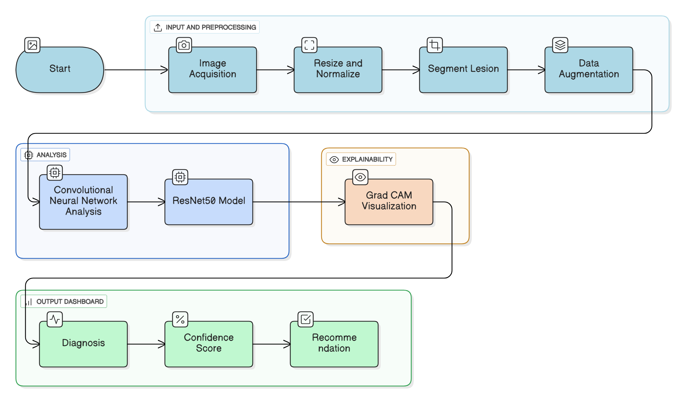
Architecture Diagram

Slide 10
Modules
Image Acquisition Module: Captures or uploads skin lesion images using smartphone or dermatoscope.
Resize and Normalize Module: Adjusts image dimensions and normalizes pixel intensity values to ensure uniform input for the model.
Segmentation Module: Extracts lesion area from the skin image to remove background noise and focus analysis on the affected region.
Data Augmentation Module: Applies transformations such as rotation, flipping, scaling, and contrast adjustments to increase dataset diversity and reduce overfitting.
Convolutional Neural Network (CNN) Analysis Module: Performs feature extraction from skin images using convolutional and pooling layers to capture texture and color patterns.
ResNet50 Model Module: Uses a pretrained ResNet50 deep learning architecture for accurate classification of skin lesion types.

Slide 11
Modules
Grad-CAM Visualization Module: Generates heatmaps highlighting important image regions contributing to the model’s decision, improving interpretability.
Diagnosis Module: Identifies and labels the type of skin disease (e.g., melanoma, lesion, etc.) based on model output.
Confidence Score Module: Provides a probability score indicating the reliability of the model’s diagnosis.
Recommendation Module: Suggests next steps (e.g., consult dermatologist, monitor lesion, or no immediate action) based on the diagnosis and confidence level.
Interface Module
Offers a user-friendly interface (web or mobile) for doctors and patients to upload images, view results, and receive recommendations.

Slide 12
Results
High-Accuracy Predictive Model
A deep learning model was successfully trained to achieve a predictive accuracy of 90%.
The model was trained and tested using the DermNet dataset.
This result successfully meets the project's core objective, which was to achieve a validation accuracy of at least 85% to ensure reliable predictions.
Fully Functional Web Application
A fully functional and user-friendly web application has been developed for diagnosis.
The platform features an intuitive dashboard where users can upload an image of a skin lesion for analysis.
The AI model processes the image in real-time to provide an instant preliminary diagnosis.
Multi-Language Support for Accessibility
The platform integrates multi-language support to make the tool accessible to a broader audience.
While the default language is English, diagnostic results can be viewed in both Hindi and Kannada.
This feature is critical for effective deployment in the diverse linguistic regions of India.

Slide 13
Software Details
Software Requirements:
  Programming: Python
  Frameworks: TensorFlow / PyTorch, Keras
  Preprocessing: OpenCV
  Deployment: Flask for backend, simple web UI for front-end, TensorFlow Lite for mobile deployment
Dataset: DermNet dataset for training and testing.

Slide 14
Timeline of the Project (Gantt Chart)
Review 1
Problem statement objectives.
Review 2
Basic ML model skin disease classification.
Review 3
Develop a mobile app.
Datasets proposed methodology.
Project objective and scope documentation.
Initial presentation of approach and planned tech stack.
Integrate the ML model into the app using TensorFlow Lite for offline prediction.
Fully functional mobile App prototype.
Final presentation/demo
Host the model on server backend.
Create a simple web interface where users can upload an image.
Working demo of model prediction via web page.

Slide 15
References (IEEE Paper format)
Deep Learning-Based Dermatological Condition Detection: A Systematic Review (IEEE)
External Validation of AI Models for Skin Diseases: A Systematic Review (IEEE)
Recent Advancements in Diagnosis of Skin Diseases Using ML/DL: A Review (MDPI, Diagnostics)
  The Emerging Role of AI in Dermatology: A Systematic Review (MDPI, Dermato)
The Use of AI for Skin Disease Diagnosis in Primary Care (MDPI, Healthcare)
Recent Advances in Diagnosis of Skin Lesions Using Dermoscopy (IEEE)
High-Precision Skin Disease Diagnosis via DL on Dermoscopic Images (MDPI, Bioengineering)
Interpretable AI for Enhanced Skin Lesion Classification (MDPI, Diagnostics)
AI for Skin Disease Diagnosis in Primary Care: A Systematic Review (MDPI, Applied Sciences)
Multimodal Approach Using Telegram Chatbot (IEEE)

Slide 16


